Slide 1
API-driven Cloud Native Solutions
Notes:
Hello everyone!

Slide 2
CC ZG506
Lectures No. 6 and No. 7

Slide 3
Agenda
Machine Learning
Generations
Machine Learning Pipeline
MLOps
Tools: MLFlow and AWS SageMaker
API-driven ML pipelines
Model Development and Training
Model Deployment
Monitoring
Scalability
Notes:
This slide outlines the agenda for a session or presentation focused on Machine Learning (ML) and its associated tools and processes. Here's a breakdown of the contents:
Machine Learning:
A general introduction to the field of Machine Learning, likely covering its fundamental concepts, types (supervised, unsupervised, etc.), and importance.
Generations:
Discussion on the evolution or "generations" of ML technologies or models, potentially exploring traditional ML, deep learning, and recent advancements like generative AI.
Machine Learning Pipeline:
An overview of the steps involved in the ML lifecycle, such as data collection, preprocessing, model building, validation, deployment, and monitoring.
MLOps:
Insights into "Machine Learning Operations," a discipline combining ML and DevOps to streamline and automate ML workflows. Topics might include versioning, reproducibility, and continuous integration/deployment for ML models.
Tools: MLFlow and AWS SageMaker:
A focus on tools used for ML lifecycle management:
MLFlow: An open-source platform for managing the ML lifecycle, including experiment tracking, model registry, and deployment.
AWS SageMaker: A cloud-based ML service offering tools for building, training, and deploying models at scale.
API-driven ML Pipelines:
Explanation of pipelines that use APIs for different stages of the ML process:
Model Development and Training: Building and training models using APIs.
Model Deployment: Deploying models for real-world use, ensuring accessibility.
Monitoring: Tracking model performance, identifying issues, and retraining when necessary.
Scalability: Ensuring the system can handle increasing data and usage demands.
This agenda suggests a comprehensive session aimed at professionals or students interested in understanding ML workflows, tools, and best practices for implementation.

Slide 4
Machine Learning

Slide 5
Machine Learning
Machine learning (ML) is a branch of artificial intelligence (AI) and computer science that focuses on using data and algorithms to enable AI to imitate the way that humans learn, gradually improving its accuracy.
Notes:
This slide provides a concise definition of Machine Learning (ML):
ML as a Subset of AI:
It describes Machine Learning as a branch of Artificial Intelligence (AI) and computer science. This emphasizes that ML is one of the key components of AI, focusing on the development of systems capable of learning and adapting autonomously.
Data and Algorithms:
The slide highlights the central role of data and algorithms in ML. These elements are the foundation upon which machine learning systems operate, learning patterns and making decisions without being explicitly programmed.
Imitation of Human Learning:
It explains that ML aims to mimic human learning processes. By analyzing data, models iteratively learn to make predictions or take actions, improving their accuracy over time.
Goal of Continuous Improvement:
The definition underscores that ML systems are designed to gradually improve their performance and accuracy, making them adaptive to new data and changing environments.
This slide likely serves as an introductory foundation for understanding Machine Learning in the broader context of AI.

Slide 6
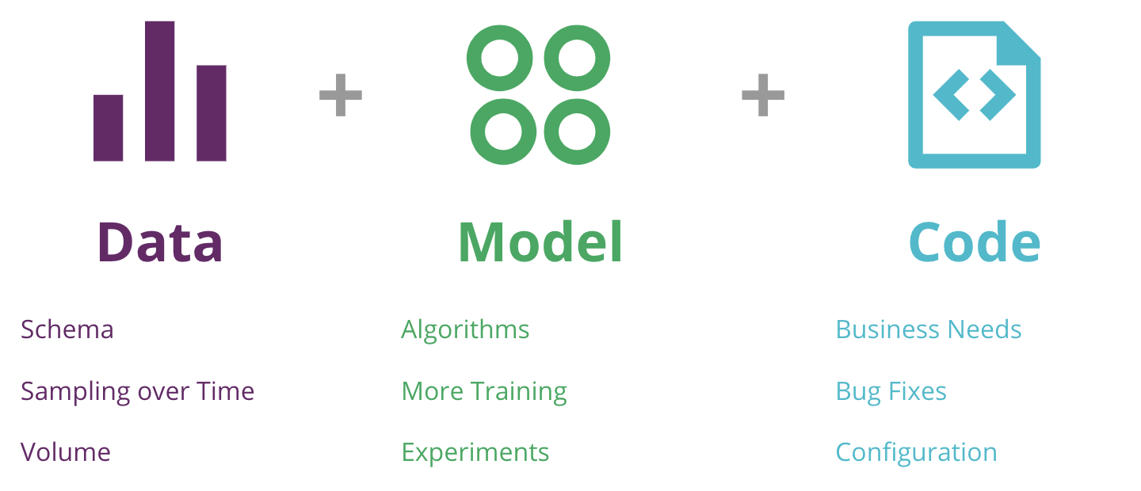
Machine Learning Complexity
Number of changing variables - 3 (Data, Model and Code), whereas in pure software development, only changing variable is Code
https://martinfowler.com/articles/cd4ml.html
Notes:
This slide explains the complexity of Machine Learning (ML) compared to traditional software development by identifying the three key components that make ML systems more dynamic and variable:
Key Components in ML Systems
Data:
Represents the foundational input for training ML models.
Challenges:
Schema: The structure of the data can change over time, requiring updates to the pipeline.
Sampling over Time: Data distributions might evolve, leading to concept drift.
Volume: As the dataset grows, it can impact computation and storage requirements.
Model:
Refers to the algorithms and mathematical frameworks used for training and predictions.
Challenges:
Algorithms: Models might need updates to improve performance or address changing requirements.
More Training: Continuous training on new or updated datasets is often required.
Experiments: Tuning hyperparameters or testing new models introduces variability.
Code:
Involves the traditional software engineering aspect of ML systems.
Challenges:
Business Needs: Code must adapt to changing business logic or requirements.
Bug Fixes: Addressing software bugs or errors.
Configuration: Managing and updating configurations for deployment and execution.
Comparison with Traditional Software Development
In traditional software development, code is typically the primary variable.
In ML systems, data, models, and code all contribute as changing variables, significantly increasing complexity.
Reference
The slide cites Martin Fowler's article on "Continuous Delivery for Machine Learning (CD4ML)" to emphasize the dynamic and iterative nature of ML systems.
This slide aims to highlight the multi-dimensional challenges in managing and maintaining ML systems compared to traditional software projects.

Slide 7
Model in ML
A model in Machine Learning is the trained algorithm used to make predictions or decisions, and it forms the core of a machine learning system that is developed, deployed, monitored, and maintained as part of an operational pipeline.
Notes:
This slide explains the concept of a Model in Machine Learning (ML) and its role within an ML system:
Key Points
Definition:
A model in ML is defined as the trained algorithm that enables predictions or decisions based on input data. It is the output of the ML process after being trained on a dataset.
Core Component:
The model is at the heart of an ML system. Without a trained model, the system cannot perform the tasks it was designed for, such as classification, regression, clustering, or decision-making.
Integration into Operational Pipelines:
The model does not work in isolation. It is:
Developed: Using data and algorithms to train a suitable model.
Deployed: Integrated into production environments to be used in real-world applications.
Monitored: Continuously checked for performance, accuracy, and relevance (e.g., detecting data drift).
Maintained: Regularly updated or retrained with new data to ensure optimal performance.
This slide emphasizes the practical and dynamic role of an ML model, underscoring its importance not just as an algorithm but as a functional component of a larger, operational system.

Slide 8
Model Workflow
Model Development: Building and training the model using training data. This involves selecting an algorithm, tuning hyper parameters, and evaluating performance.
Model Versioning: Keeping track of different versions of a model, which may be developed over time to improve accuracy or adapt to new data.
Model Deployment: Taking the trained model and deploying it into a production environment where it can make predictions on live data.
Model Monitoring: Continuously monitoring the model's performance in production to ensure that it is accurate and effective. This may involve detecting data drift, model degradation, or biases.
Model Retraining: Updating or retraining the model periodically with new data to maintain its performance over time.
Notes:
This slide details the Model Workflow in Machine Learning, outlining the key stages involved in the lifecycle of an ML model:
1. Model Development:
Involves building and training the ML model using a dataset.
Key tasks:
Selecting the appropriate algorithm for the task.
Tuning hyperparameters to optimize performance.
Evaluating the model to ensure it meets the desired performance metrics.
2. Model Versioning:
Refers to maintaining a record of different versions of the model.
Purpose:
Track improvements or changes made to the model.
Manage multiple models efficiently, especially when updating to new data or algorithms.
3. Model Deployment:
Focuses on integrating the trained model into a production environment.
Objective:
Ensure the model is accessible to make predictions on live data in real-world scenarios.
4. Model Monitoring:
Continuous observation of the model’s performance in a live setting.
Tasks:
Detect data drift: Changes in the input data distribution that may impact model performance.
Identify model degradation: A drop in the model's accuracy over time.
Address emerging biases or inaccuracies in predictions.
5. Model Retraining:
Regularly updating the model with new data to ensure its effectiveness over time.
Importance:
Keeps the model relevant as data evolves.
Addresses performance drops due to changes in the data environment.
Summary:
This workflow encapsulates the end-to-end process required to create, deploy, and maintain an ML model in a robust and scalable manner. It highlights the iterative nature of ML development, emphasizing monitoring and retraining for long-term success.

Slide 9
Machine Learning Generations
Notes:
This slide introduces the topic of Machine Learning Generations. It likely sets the stage for a discussion about the evolution and milestones in Machine Learning over time.
Possible Content that Follows
First Generation (Traditional ML):
Focused on simple algorithms like linear regression, decision trees, and rule-based systems.
Relied heavily on feature engineering by domain experts.
Second Generation (Deep Learning):
Introduction of neural networks and their deep variants.
Use of GPUs and large datasets for tasks like image recognition, natural language processing, etc.
Third Generation (Generative AI):
Models like GPT (Generative Pre-trained Transformer) and other advanced architectures.
Focus on unsupervised and self-supervised learning, enabling generative capabilities like text generation and image synthesis.
Future Directions:
Areas like explainable AI (XAI), federated learning, and quantum machine learning.
This slide acts as a transition point to dive into how machine learning has progressed and where it is headed. The image of the clock tower suggests it might also tie into the rich academic tradition or history, possibly linking BITS Pilani's contributions to the field.

Slide 10
Three Generations of ML
Gen 1: Basic Machine Learning
Gen 2: Deep Learning [based on Artificial Neural Networks]
Gen 3: Transfer Learning / Transformers
Notes:
This slide categorizes the Three Generations of Machine Learning (ML), illustrating the progression and key focus areas of the field over time:
1. Gen 1: Basic Machine Learning:
Refers to the foundational phase of ML.
Key features:
Algorithms like linear regression, logistic regression, decision trees, and support vector machines.
Heavy reliance on manual feature engineering by domain experts to extract meaningful input for models.
Focus on small to medium-sized datasets.
Applications:
Spam detection, recommendation systems, and basic classification tasks.
2. Gen 2: Deep Learning [based on Artificial Neural Networks]:
Represents a significant shift towards neural networks and their deep architectures.
Key features:
Use of deep learning models, such as convolutional neural networks (CNNs) and recurrent neural networks (RNNs), for tasks like image and speech recognition.
Requires large datasets and high computational power (e.g., GPUs).
Minimal need for manual feature engineering, as deep learning models can learn features automatically.
Applications:
Computer vision, natural language processing, and autonomous vehicles.
3. Gen 3: Transfer Learning / Transformers:
The current state-of-the-art in ML, emphasizing reusable knowledge and efficient architectures.
Key features:
Transfer Learning: Leverages pre-trained models on large datasets to adapt to specific tasks with minimal fine-tuning.
Transformers: A model architecture designed to handle sequential data efficiently (e.g., text, time series). Examples include BERT, GPT, and Vision Transformers.
Focus on self-supervised learning for extracting meaningful representations without labeled data.
Applications:
Chatbots, advanced language models (e.g., ChatGPT), and generative AI (text-to-image, code generation).
Summary:
The slide provides a high-level overview of the evolution of ML, moving from traditional algorithms to deep learning and finally to advanced techniques like transformers and transfer learning. It highlights the field's increasing capability to process large data, reduce manual effort, and solve complex real-world problems.

Slide 11
Gen 1. Basic Machine Learning
This generation includes traditional machine learning algorithms that rely on manually engineered features and mathematical models to find patterns in data. These algorithms typically perform well on structured data and smaller datasets.
Algorithms for solving Classification problems:
Naïve Bayes
Decision Tree
Random Forest
Support Vector Machine (SVM)
K-Nearest Neighbors (KNN)
Logistic Regression
Notes:
This slide explains Generation 1: Basic Machine Learning, focusing on traditional ML techniques and their use in solving classification problems. Here's a breakdown:
Key Characteristics of Basic Machine Learning:
Traditional Algorithms:
Relies on classical machine learning algorithms that have a mathematical foundation.
Focus on structured data and relatively small datasets.
Manual Feature Engineering:
Significant effort is required to manually extract relevant features from the data to improve model performance.
Performance:
These models perform well on problems where data is structured, clean, and limited in size.
Algorithms for Solving Classification Problems:
The slide lists popular algorithms commonly used in the first generation of ML for classification tasks:
Naïve Bayes:
A probabilistic classifier based on Bayes' theorem.
Assumes independence between features.
Decision Tree:
A tree-structured model that splits data based on feature values to make decisions.
Random Forest:
An ensemble learning method combining multiple decision trees to improve accuracy and reduce overfitting.
Support Vector Machine (SVM):
A model that finds the hyperplane that best separates data points into different classes.
K-Nearest Neighbors (KNN):
A non-parametric algorithm that classifies data points based on the majority class of their nearest neighbors.
Logistic Regression:
A linear model used for binary classification tasks, estimating the probability of a class using a logistic function.
Conclusion:
This slide emphasizes the foundational phase of ML, where the focus was on using interpretable models and structured data. These algorithms are still widely used for various tasks due to their simplicity and efficiency in specific use cases.

Slide 12
Gen 2. Deep Learning
Deep Learning models are based on artificial neural networks with many layers (hence "deep") that automatically learn features from the data. They perform well on large datasets and can handle unstructured data such as images, text, and audio.
Convolutional Neural Networks (CNNs) - for Image Processing & Video Analysis
Recurrent Neural Networks (RNNs) - NLP, speech recognition, and time series analysis
Long Short-Term Memory Networks (LSTMs) - NLP
Notes:
This slide focuses on Generation 2: Deep Learning, describing its foundational concepts, capabilities, and key architectures:
Overview of Deep Learning:
Based on Artificial Neural Networks:
Deep learning models utilize multiple layers of interconnected nodes (neurons), enabling them to learn complex patterns and representations in data.
The "deep" aspect refers to the number of layers in the network.
Automatic Feature Learning:
Unlike traditional ML, deep learning models automatically extract features from raw data, eliminating the need for manual feature engineering.
Handling Unstructured Data:
Excels in processing unstructured data types such as:
Images
Text
Audio
Performance:
Works well with large datasets, leveraging computational power from GPUs and TPUs.
Key Deep Learning Architectures:
Convolutional Neural Networks (CNNs):
Designed for image and video data.
Applications:
Image classification, object detection, and video analysis.
Examples: ResNet, VGGNet, and AlexNet.
Recurrent Neural Networks (RNNs):
Specialized for sequential data processing.
Applications:
Natural Language Processing (NLP), speech recognition, and time-series forecasting.
Examples: Text generation, chatbots.
Long Short-Term Memory Networks (LSTMs):
An advanced type of RNN designed to handle long-term dependencies in sequences.
Applications:
NLP tasks such as sentiment analysis and machine translation.
Speech recognition and time-series prediction.
Conclusion:
Deep learning represents a significant leap in ML capabilities by enabling automatic feature extraction and working effectively with unstructured data. The architectures discussed are foundational to many modern AI applications, ranging from computer vision to NLP.

Slide 13
Gen 3. Transfer Learning / Transformers
This generation leverages pre-trained models on large datasets and fine-tunes them on specific tasks. Transfer learning and transformers allow models to learn more effectively with less data and training time.
Ex: Fine-tuning BERT (Bidirectional Encoder Representations from Transformers) for specific NLP tasks like sentiment analysis, language translation etc.
Notes:
This slide explains Generation 3: Transfer Learning / Transformers, focusing on advancements that make machine learning more efficient and adaptable.
Key Concepts:
Transfer Learning:
Transfer learning leverages pre-trained models trained on large datasets and adapts them for specific tasks.
This approach significantly reduces:
Data requirements: Less labeled data is needed for fine-tuning.
Training time: Pre-trained models already contain useful knowledge.
Transformers:
Transformer architectures have revolutionized Natural Language Processing (NLP) and other domains by handling sequential data more effectively than traditional methods like RNNs.
They utilize self-attention mechanisms, enabling them to understand context and relationships in data.
Benefits:
Efficiency:
Models learn faster and perform better with limited task-specific data.
Scalability:
Handles large-scale data and tasks efficiently.
Versatility:
Can be applied across multiple domains, such as NLP, computer vision, and speech.
Example:
Fine-tuning BERT (Bidirectional Encoder Representations from Transformers):
BERT is a transformer-based model that is pre-trained on massive text corpora.
Fine-tuning allows adapting BERT for specific tasks like:
Sentiment analysis
Language translation
Text summarization
Conclusion:
This generation represents a significant leap in ML efficiency, enabling tasks to be accomplished with fewer resources and advancing the field through innovations like transformers and transfer learning. These approaches form the backbone of many state-of-the-art AI applications today.

Slide 14
Transfer Learning
Transfer learning is a deep-learning technique where a model is first pre-trained on a data-rich task before being fine-tuned on a downstream task, has emerged as a powerful technique in natural language processing (NLP).
The effectiveness of transfer learning has given rise to a diversity of approaches, methodology, and practice.
Notes:
This slide provides an overview of Transfer Learning, a significant advancement in deep learning. Here's a detailed explanation:
What is Transfer Learning?
Transfer learning is a deep learning technique where:
A model is pre-trained on a large, data-rich task (often a generic task like language modeling or image classification).
The pre-trained model is then fine-tuned on a specific downstream task with less data.
It is particularly powerful in domains where labeled data is scarce.
Applications in NLP:
Transfer learning has become a cornerstone technique in Natural Language Processing (NLP).
Examples:
Pre-training a model like BERT or GPT on vast corpora of text data.
Fine-tuning the pre-trained model on tasks like:
Sentiment analysis
Language translation
Question answering
These models capture a general understanding of language, which can be easily adapted to specific tasks.
Impact and Advancements:
Diversity of Approaches:
Transfer learning has led to new methodologies, such as:
Pre-trained embeddings for words and sentences.
Adapting large-scale transformers for task-specific purposes.
Effectiveness:
Reduces the computational cost and time needed for training models from scratch.
Improves performance by leveraging knowledge from broader data sources.
Conclusion:
Transfer learning represents a paradigm shift in deep learning, enabling more efficient and effective model development across a wide range of applications, particularly in NLP. Its versatility has driven innovations in methodologies and practices, cementing its role in modern AI.

Slide 15
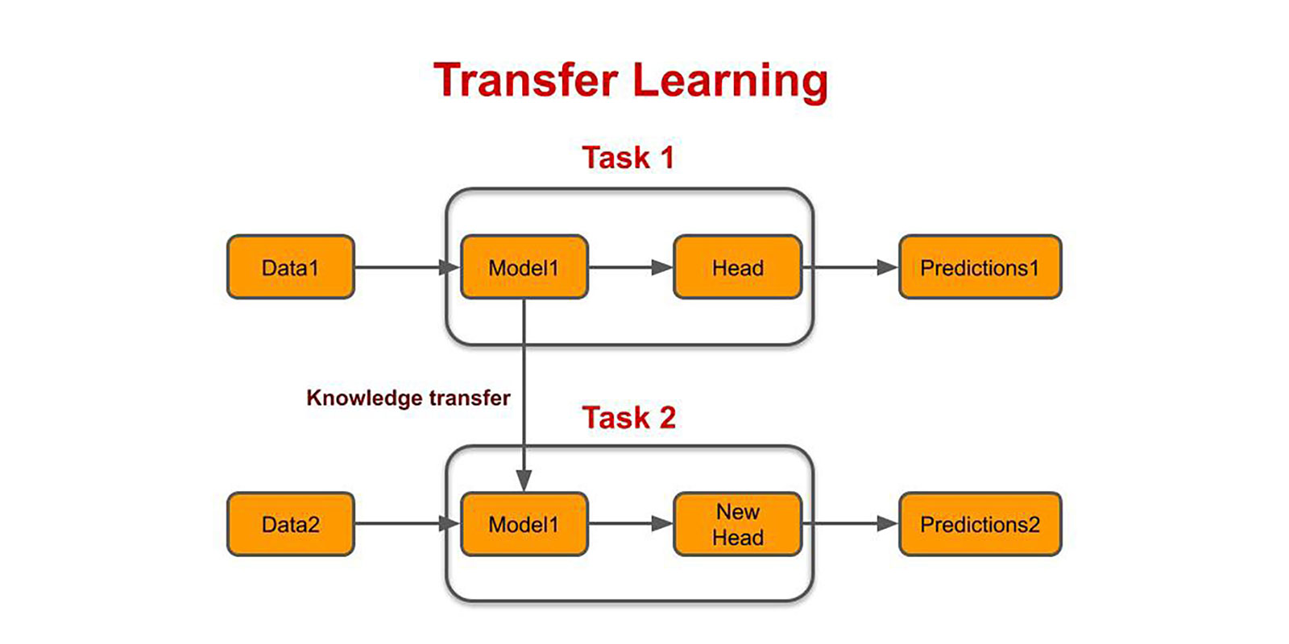
Transfer Learning
Model developed for task 1 is reused for other tasks
Notes:
This slide provides a visual representation of Transfer Learning, illustrating how knowledge gained from one task can be reused for another task with similar or related data. Here's a detailed explanation of the process:
Diagram Explanation:
Task 1:
Data1: The initial dataset used for training a model.
Model1: A base model trained on Task 1 using Data1.
Head: The task-specific layer added to Model1 to make predictions (e.g., classification, regression).
Predictions1: The output of Task 1 after training is complete.
Knowledge Transfer:
The trained Model1 (excluding the task-specific head) is transferred to a new task.
The base model retains knowledge learned from Task 1, such as feature representations and patterns from Data1.
Task 2:
Data2: A new dataset for a different but related task.
Model1: The same base model from Task 1 is reused without re-training from scratch.
New Head: A new task-specific layer is added to adapt the model for Task 2.
Predictions2: The output of Task 2 after fine-tuning Model1 on Data2.
Key Insights:
Reusing Models:
The base model developed for Task 1 acts as a pre-trained model for Task 2, saving significant computational resources and reducing the need for large amounts of labeled data.
Fine-Tuning:
Instead of retraining the entire model, only the new head is trained using Task 2 data, adapting the model to the new task.
Versatility:
Transfer learning is particularly useful in scenarios where:
Limited labeled data is available for Task 2.
The tasks share underlying similarities (e.g., both involve image recognition or language processing).
Example Use Cases:
A model trained on a large corpus for language modeling (Task 1) can be fine-tuned for sentiment analysis (Task 2).
A model trained on general image data can be fine-tuned for specific applications like medical imaging.
Conclusion:
Transfer learning allows efficient model reuse, leveraging previously learned knowledge to solve new, related problems with minimal additional resources. This process is a cornerstone of modern AI practices, enabling rapid deployment of effective models across diverse domains.

Slide 16
Transformer Models
Sl. No | Transformer Model | Company & Info
1 | BERT (Bidirectional Encoder Representations from Transformers) BERT Base - 12 encoder & 768 hidden layers BERT Large - 24 encoder & 1024 hidden layers | Google Pre-trained on unlabeled data extracted from BookCorpus with 800M words and English Wikipedia with 2500M words Machine Translation, Question Answering
2 | GPT (Generative Pre-trained Transformer) GPT-2 -> Trained for 1.5B parameters for a dataset of 8 Million Web Pages GPT-3 -> Trained on 570GB of text from Textbooks and Wikipedia GPT-NEO -> Open source version of GPT-3 GPT 3.5 / 4.0 / 4o -> ChatGPT is trained on this model | OpenAI Text Generation or Word prediction, question answering, summarization
3 | T5 (Text-To-Text-Transfer-Transformer Model) | Question Answering, Language Translation
4 | RoBERTa (Robustly Optimized BERT Pretraining Approach) Trained on 360GB of text | Facebook Multi-class Text Classification
All these models support Deep Learning Libraries TensorFlow (Google) and PyTorch (Facebook)
Notes:
This slide provides an overview of Transformer Models, detailing key models, their developers, and applications. Here's a breakdown:
1. BERT (Bidirectional Encoder Representations from Transformers)
Developer: Google
Specifications:
BERT Base: 12 encoder layers, 768 hidden layers.
BERT Large: 24 encoder layers, 1024 hidden layers.
Pre-training Dataset:
BookCorpus (800M words) and English Wikipedia (2500M words).
Applications:
Machine translation, question answering, and other NLP tasks.
Highlights:
Trains bidirectionally, capturing context from both directions in a sentence.
2. GPT (Generative Pre-trained Transformer)
Developer: OpenAI
Versions:
GPT-2:
Trained with 1.5 billion parameters on 8 million web pages.
GPT-3:
Trained on 570GB of text from textbooks, Wikipedia, and other sources.
GPT-NEO:
Open-source alternative to GPT-3.
GPT-3.5/4/4.0:
ChatGPT is based on these models.
Applications:
Text generation, word prediction, question answering, summarization, and more.
3. T5 (Text-To-Text Transfer Transformer Model)
Developer: Google
Applications:
Question answering, language translation, and other NLP tasks.
Highlights:
Reformulates NLP tasks as a text-to-text problem, allowing for a unified training approach.
4. RoBERTa (Robustly Optimized BERT Pretraining Approach)
Developer: Facebook
Dataset:
Trained on 360GB of text.
Applications:
Multi-class text classification and other NLP tasks.
Highlights:
An optimized version of BERT with more robust pretraining techniques.
Additional Notes:
Libraries Supported:
All these models are compatible with popular deep learning libraries:
TensorFlow (Google)
PyTorch (Facebook)
These libraries provide the infrastructure to train, fine-tune, and deploy these models.
Conclusion:
The table highlights the versatility and impact of transformer models across NLP applications, emphasizing their scalability and compatibility with leading AI tools and libraries. These models have become the backbone of modern AI systems.

Slide 17
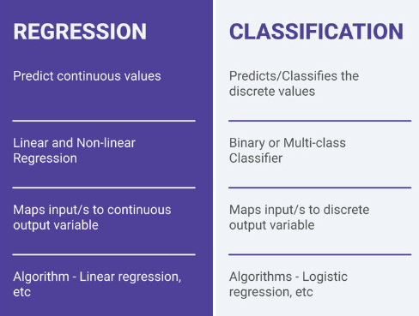
Machine Learning Types
Search for Datasets and Models - https://www.kaggle.com/
Notes:
This slide discusses two primary types of machine learning problems: Regression and Classification, highlighting their characteristics and distinctions.
1. Regression
Definition:
Regression models are used to predict continuous values based on input variables.
Characteristics:
Handles problems where the output variable is a continuous range (e.g., house prices, temperatures).
Can be linear or non-linear, depending on the relationship between input and output.
Maps input(s) to a continuous output variable.
Example Algorithm:
Linear Regression: Finds a linear relationship between independent and dependent variables.
Other examples: Polynomial regression, Ridge regression.
Applications:
Predicting stock prices, forecasting weather, or estimating demand.
2. Classification
Definition:
Classification models are used to predict discrete values (categories or classes).
Characteristics:
Used for binary or multi-class classification tasks.
Maps input(s) to a discrete output variable (e.g., yes/no, categories like spam/not spam).
Example Algorithm:
Logistic Regression: Despite its name, it's used for binary classification tasks.
Other examples: Decision trees, Support Vector Machines (SVMs), and Neural Networks.
Applications:
Spam email detection, image recognition, or diagnosing diseases.
Additional Information:
The slide provides a useful reference: https://www.kaggle.com/
Kaggle is a platform where users can find datasets, pre-trained models, and solutions for both regression and classification tasks.
Conclusion:
This slide offers a foundational understanding of regression and classification tasks, emphasizing the type of output (continuous vs. discrete) and the corresponding algorithms. These concepts form the basis of most machine learning applications.

Slide 18
Machine Learning Process
Based on the type of problem (regression or classification), select one primary model and one or more secondary models and evaluate their performance.
Revise the model(s) to include more predictors.
Select the best performing model based on the evaluation metrics.
Notes:
This slide outlines the Machine Learning Process, providing a high-level framework for building and selecting the best machine learning model.
Steps in the Machine Learning Process:
Problem Identification and Model Selection:
Based on the type of problem (regression or classification), select:
A primary model that is most suitable for the task.
Secondary models to serve as alternatives for comparison.
Evaluate Performance:
Assess the performance of the models using appropriate evaluation metrics (e.g., accuracy, precision, recall, RMSE).
Model Revision and Feature Addition:
Revise the models by:
Incorporating additional predictors (features) to improve accuracy.
Refining the hyperparameters or structure of the models based on performance evaluation.
Model Selection:
After evaluation, select the best-performing model based on:
Evaluation metrics that align with the problem's goals (e.g., minimizing error or maximizing classification accuracy).
Practical considerations like training time, interpretability, and scalability.
Key Insights:
Iterative Process:
Model building and evaluation are iterative, requiring adjustments and re-evaluations to achieve optimal performance.
Evaluation Metrics:
Metrics should match the problem type (e.g., regression tasks use metrics like RMSE, while classification tasks use accuracy, F1-score, etc.).
Conclusion:
This slide emphasizes the structured and iterative approach required to develop effective machine learning models. By comparing multiple models and iterating on features and parameters, the process ensures the selection of the most suitable model for the given problem.

Slide 19
Model Evaluation Metrics
Evaluation Metrics vary based on type of models:
Regression Models
Mean Absolute Error (MAE)
Root mean squared error (RMSE)
R Squared or Adjusted R Square
Classification Models
Confusion Matrix
Accuracy (%)
Precision
Recall
F1-score
Refer PPT – “Classification - Confusion Matrix and Metric calculations"
Notes:
This slide discusses Model Evaluation Metrics, which vary depending on the type of machine learning model (regression or classification). Here's a detailed breakdown:
Evaluation Metrics for Regression Models:
Mean Absolute Error (MAE):
Measures the average magnitude of errors in predictions.
Formula: MAE=1n∑i=1n∣yi−y^i∣\text{MAE} = \frac{1}{n} \sum_{i=1}^n |y_i - \hat{y}_i|MAE=n1​∑i=1n​∣yi​−y^​i​∣
Lower values indicate better model performance.
Root Mean Squared Error (RMSE):
A common metric that gives more weight to large errors.
Formula: RMSE=1n∑i=1n(yi−y^i)2\text{RMSE} = \sqrt{\frac{1}{n} \sum_{i=1}^n (y_i - \hat{y}_i)^2}RMSE=n1​∑i=1n​(yi​−y^​i​)2​
Useful for understanding how far predictions deviate from actual values.
R-Squared (R²) or Adjusted R-Squared:
Measures the proportion of variance in the dependent variable explained by the model.
Adjusted R² accounts for the number of predictors, avoiding overfitting.
Higher values (closer to 1) indicate better model performance.
Evaluation Metrics for Classification Models:
Confusion Matrix:
Summarizes the performance of a classification model by showing:
True Positives (TP), True Negatives (TN), False Positives (FP), and False Negatives (FN).
Accuracy:
Percentage of correct predictions.
Formula: Accuracy=TP+TNTP+TN+FP+FN\text{Accuracy} = \frac{TP + TN}{TP + TN + FP + FN}Accuracy=TP+TN+FP+FNTP+TN​
Precision:
Focuses on the accuracy of positive predictions.
Formula: Precision=TPTP+FP\text{Precision} = \frac{TP}{TP + FP}Precision=TP+FPTP​
Recall:
Measures the ability to identify all positive cases.
Formula: Recall=TPTP+FN\text{Recall} = \frac{TP}{TP + FN}Recall=TP+FNTP​
F1-Score:
A harmonic mean of Precision and Recall.
Formula: F1=2×Precision×RecallPrecision+Recall\text{F1} = 2 \times \frac{\text{Precision} \times \text{Recall}}{\text{Precision} + \text{Recall}}F1=2×Precision+RecallPrecision×Recall​
Useful when Precision and Recall are both important.
Additional Note:
The slide references another PPT titled "Classification - Confusion Matrix and Metric Calculations" for further details on metric calculations.
Conclusion:
This slide emphasizes the importance of selecting appropriate evaluation metrics based on the model type. For regression, metrics focus on continuous prediction accuracy, while for classification, metrics assess the model's ability to categorize data correctly. Proper evaluation ensures robust and reliable model performance.

Slide 20
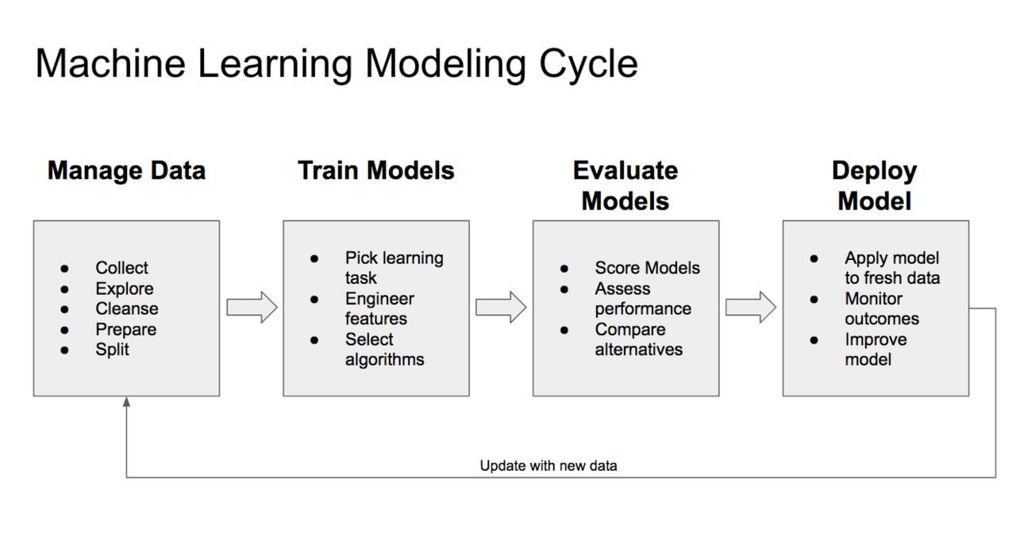
Machine Learning Life Cycle
Notes:
This slide presents the Machine Learning Life Cycle, detailing the essential steps involved in the development and deployment of a machine learning model. Here's an explanation of each stage:
1. Manage Data
Objective: Prepare and structure the data for model development.
Key steps:
Collect: Gather raw data from various sources.
Explore: Perform exploratory data analysis (EDA) to understand data patterns, distributions, and relationships.
Cleanse: Handle missing values, outliers, and noisy data.
Prepare: Transform data into a usable format (e.g., feature scaling, encoding categorical variables).
Split: Divide the data into training, validation, and testing sets to prevent overfitting and ensure model generalization.
2. Train Models
Objective: Develop and train a machine learning model.
Key steps:
Pick learning task: Decide whether the problem is regression, classification, clustering, etc.
Engineer features: Select or create the most relevant input variables for the model.
Select algorithms: Choose the appropriate machine learning algorithm(s) for the task.
3. Evaluate Models
Objective: Assess the performance and reliability of the model.
Key steps:
Score models: Use evaluation metrics (e.g., accuracy, RMSE, precision, recall) to measure performance.
Assess performance: Compare results across different models or configurations.
Compare alternatives: Evaluate multiple algorithms or variations to identify the best-performing model.
4. Deploy Model
Objective: Use the trained model in a production environment to make predictions.
Key steps:
Apply model to fresh data: Use unseen data for predictions in real-world applications.
Monitor outcomes: Continuously track model performance to detect issues like data drift or model degradation.
Improve model: Update or retrain the model as new data becomes available.
Iterative Process:
The cycle is iterative, allowing for continuous improvement. As new data is collected, it feeds back into the Manage Data phase to refine the model further.
Conclusion:
This life cycle ensures a structured and iterative approach to developing machine learning models, from data preparation to deployment and monitoring. Each step is critical for building robust, scalable, and effective models that perform well in real-world scenarios.

Slide 21
SEMMA Methodology

Slide 22
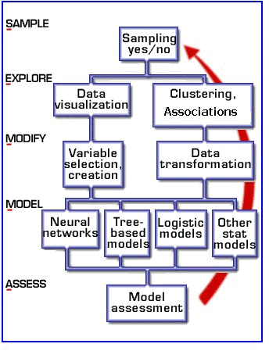
SEMMA
SEMMA stands for Sample, Explore, Modify, Model, Assess
SEMMA is focused on the model development aspects of data science, ideal for “Machine Learning” projects
Ideal for the Data Analyst / Data Scientist roles
Notes:
The slide introduces the SEMMA process, a methodology used in data mining and machine learning for systematic data analysis and model development. Here's an explanation of each component:
SEMMA:
SEMMA stands for:
Sample
Explore
Modify
Model
Assess
This process focuses on the model development aspects of data science and is especially useful for machine learning projects.
Steps in the SEMMA Process:
Sample:
Purpose: To extract a representative portion of data for analysis.
Steps:
Decide whether sampling is necessary.
Ensure the sample is large enough to represent the entire dataset while being computationally manageable.
Explore:
Purpose: To understand the data and its patterns.
Steps:
Perform data visualization to uncover trends and distributions.
Conduct clustering or identify associations between variables.
Modify:
Purpose: To prepare data for modeling.
Steps:
Variable selection/creation: Choose the most relevant features and create new ones if needed.
Data transformation: Standardize, normalize, or encode data to make it suitable for algorithms.
Model:
Purpose: To apply machine learning algorithms to the prepared data.
Steps:
Train models such as:
Neural networks
Tree-based models
Logistic regression
Other statistical or machine learning models.
Assess:
Purpose: To evaluate the model’s performance and reliability.
Steps:
Conduct model assessment using metrics like accuracy, RMSE, precision, recall, etc.
Compare models and choose the best-performing one.
Key Features:
SEMMA is a structured and iterative process.
Focused on the data-driven aspects of machine learning, from preparation to model evaluation.
Ideal for Data Analysts and Data Scientists working on ML projects.
Conclusion:
SEMMA provides a robust framework for managing the end-to-end process of building machine learning models. It ensures a systematic approach, particularly for data-heavy projects, making it a valuable methodology for professionals in data science and analytics.

Slide 23
SEMMA
1. Sample
Sampling the data by extracting a portion of a large data set big enough to contain the significant information, yet small enough to manipulate quickly.
Partitioning the data to create training and test samples.
Identifying dependent and independent variables influencing the process.
2. Explore
Exploration of the data by searching for unanticipated trends and anomalies in order to gain understanding and ideas.
Perform Univariate analysis (single variable) and multivariate analysis (relationships)
3. Modify
Modification of the data by creating, selecting, and transforming the variables to focus the model selection process.
Notes:
This slide elaborates on the first three steps of the SEMMA process: Sample, Explore, and Modify, which are critical for preparing and understanding data for modeling.
1. Sample
Objective: Extract a manageable yet representative portion of the dataset.
Key activities:
Extracting data: Ensure the sample contains significant information while being small enough for efficient manipulation.
Data partitioning: Split the dataset into training and testing samples for model development and validation.
Variable identification: Clearly identify dependent (target) and independent (predictor) variables influencing the process.
2. Explore
Objective: Analyze the data to uncover patterns, trends, and anomalies.
Key activities:
Trend analysis: Search for unexpected trends and anomalies to better understand the dataset.
Univariate analysis: Examine individual variables to summarize data distribution (e.g., mean, variance).
Multivariate analysis: Investigate relationships between multiple variables to identify correlations and dependencies.
3. Modify
Objective: Prepare and transform the data for modeling.
Key activities:
Variable creation: Generate new features or variables that can improve the model’s performance.
Variable selection: Identify the most relevant predictors for the task, eliminating irrelevant or redundant features.
Data transformation: Apply transformations like scaling, normalization, encoding, or binning to ensure data compatibility with algorithms.
Key Takeaways:
Iterative process: These steps are revisited as new insights are uncovered during exploration and modification.
Foundation for modeling: Proper sampling, exploration, and modification significantly improve the quality and reliability of machine learning models.
This slide focuses on the importance of systematic data preparation, which is essential for achieving accurate and effective results in the later stages of SEMMA (Model and Assess).

Slide 24
SEMMA
4. Model
Apply variety of machine learning techniques to produce a projected model [Basic Machine Learning, Deep Learning, Transfer Learning]
5. Assess
Assessing the data by evaluating the usefulness and reliability of the findings from the ML process and estimate how well it performs. Deploy the selected best model.
Notes:
This slide completes the SEMMA process by detailing the final two stages: Model and Assess, focusing on applying machine learning techniques and evaluating model performance.
4. Model
Objective: Build predictive models using suitable machine learning techniques.
Activities:
Apply various ML approaches, including:
Basic Machine Learning: Techniques like linear regression, decision trees, or support vector machines.
Deep Learning: Advanced techniques using neural networks for tasks like image recognition or NLP.
Transfer Learning: Leveraging pre-trained models for tasks requiring less data or computational effort.
Develop multiple models and iterate on them to find the best fit for the problem.
5. Assess
Objective: Evaluate the performance, usefulness, and reliability of the developed models.
Activities:
Use evaluation metrics (e.g., accuracy, precision, recall, RMSE, R²) to assess the model.
Test the model on unseen data to ensure generalizability and robustness.
Compare alternative models and select the one that performs best based on the predefined evaluation criteria.
Prepare the selected model for deployment to production environments, ensuring it meets the desired performance thresholds.
Key Insights:
The Model stage focuses on experimenting with algorithms and refining predictions.
The Assess stage ensures the model is reliable and suitable for real-world use, including its deployment.
Conclusion:
Together, the "Model" and "Assess" phases of SEMMA emphasize building robust machine learning solutions and validating their effectiveness. This systematic approach ensures the final model is ready to provide actionable insights and drive decision-making.

Slide 25
SEMMA - Case Study
Covid Patient Discharge Prediction (Dataset: 2nd Wave April-2021 to June 2021)
Type of Project: Machine Learning
Sample : Dataset size: 1233 patients suffering from Covid
Explore: Univariate (Null values, Mean, basic statistics), Bivariate (correlation – pearson, chi square)
Modify : PCA (Principal Component Analysis)
Model : Feature Engineering, Subset selection
Final Variables:
X: Age, Gender, Co_morbid, Admit Date, Discharge date, days of stay, covid_severity
Y: Discharge Type (Recovered, Expired)
Models applied: Support Vector Machine, Naïve Bayes, Logistic Regression, Decision Trees, KNN, ANN, Random Forest
5. Assess : Best Accuracy: Random Forest (92%)
Notes:
This slide showcases a SEMMA case study focused on predicting Covid Patient Discharge outcomes based on data collected during the second wave (April 2021 to June 2021). Here's a step-by-step breakdown:
Project Overview:
Objective: Predict the discharge type of Covid patients (e.g., recovered or expired).
Dataset:
Size: 1,233 patients.
Variables include patient demographics, medical history, and hospital details.
SEMMA Steps in Action:
Sample:
Extracted and processed a dataset of 1,233 patient records.
Divided into training and testing sets for model development and evaluation.
Explore:
Conducted univariate analysis:
Identified missing values, calculated mean, and other basic statistics.
Performed bivariate analysis:
Used correlation techniques like Pearson and Chi-square to find relationships between variables.
Modify:
Applied Principal Component Analysis (PCA):
Reduced dimensionality to focus on the most significant variables.
Conducted feature engineering and subset selection to refine predictors.
Model:
Final Variables:
Independent (X): Age, gender, co-morbidities, admit date, discharge date, days of stay, and Covid severity.
Dependent (Y): Discharge type (recovered or expired).
Models applied:
Support Vector Machine (SVM)
Naïve Bayes
Logistic Regression
Decision Trees
K-Nearest Neighbors (KNN)
Artificial Neural Networks (ANN)
Random Forest
Assess:
Evaluated models based on accuracy.
Best Model: Random Forest, achieving an accuracy of 92%.
Key Takeaways:
The SEMMA methodology enabled systematic data preparation, model development, and evaluation.
Random Forest emerged as the best-performing algorithm, highlighting its ability to handle complex and diverse datasets effectively.
Conclusion:
This case study demonstrates the practical application of SEMMA in a real-world scenario, emphasizing its utility in developing accurate machine learning models for healthcare analytics. The structured approach ensured robust predictions for critical decision-making during the Covid-19 pandemic.

Slide 26
MLOps

Slide 27
MLOps
MLOps stands for Machine Learning Operations.
A set of practices to standardize and streamline the process of developing and deploying machine learning models.
It covers the entire machine learning workflow, including data collection, machine learning model development, training, deployment, and model management.
https://www.databricks.com/glossary/mlops
Notes:
This slide introduces MLOps, or Machine Learning Operations, a set of best practices designed to enhance the process of developing and deploying machine learning models. Here's a detailed explanation:
What is MLOps?
Definition:
MLOps is a practice focused on standardizing, automating, and streamlining the machine learning (ML) lifecycle to ensure efficient model deployment and operation.
Goal:
Bridge the gap between machine learning development and operationalization (deployment and maintenance).
Key Features of MLOps:
Comprehensive Workflow Coverage:
MLOps spans the entire machine learning lifecycle, including:
Data collection: Automating and managing datasets for training.
Model development: Ensuring reproducibility and collaboration in model design and experimentation.
Training and testing: Streamlining training pipelines and validating model performance.
Deployment: Automating the deployment of models into production.
Monitoring and management: Continuously monitoring models for drift, accuracy, and resource utilization.
Standardization:
Establishes a set of guidelines and tools to ensure consistency across ML workflows.
Collaboration:
Encourages collaboration between data scientists, ML engineers, and IT/DevOps teams for seamless model integration into production systems.
Why is MLOps Important?
Ensures scalability: Enables organizations to scale machine learning efforts efficiently.
Promotes reproducibility: Makes it easier to reproduce results, even with evolving data and changing requirements.
Enhances efficiency: Reduces the time taken to move models from development to deployment.
Ensures reliability: Enables continuous monitoring to maintain model accuracy and performance.
Conclusion:
MLOps is essential for organizations deploying machine learning at scale. By providing a structured and standardized approach, it ensures that machine learning models remain accurate, efficient, and effective over time.
For more information, the slide references Databricks' MLOps glossary: https://www.databricks.com/glossary/mlops.

Slide 28
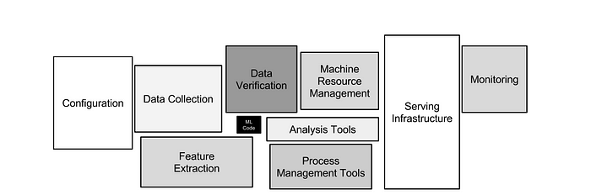
Why is MLOps Important
Productionizing machine learning is difficult. The machine learning lifecycle consists of many complex components such as data ingest, data prep, model training, model tuning, model deployment, model monitoring, explainability, and much more. It also requires collaboration and hand-offs across teams, from Data Engineering to Data Science to ML Engineering
https://proceedings.neurips.cc/paper/2015/file/86df7dcfd896fcaf2674f757a2463eba-Paper.pdf
Notes:
This slide explains Why MLOps is Important, focusing on the challenges of operationalizing machine learning and the need for collaboration across teams.
Key Points:
Complexity of the Machine Learning Lifecycle:
Productionizing machine learning involves numerous interconnected components, including:
Data ingestion: Collecting data from various sources.
Data preparation: Cleaning, transforming, and organizing data.
Model training and tuning: Building and optimizing ML models.
Model deployment: Implementing models in production environments.
Model monitoring: Ensuring models remain accurate and reliable.
Explainability: Making model decisions interpretable and understandable.
Each step requires significant effort and precise coordination.
Collaboration Across Teams:
Effective MLOps demands collaboration between:
Data Engineering: Ensuring data availability and quality.
Data Science: Designing and developing predictive models.
ML Engineering: Managing infrastructure, scalability, and automation.
Hand-offs between these teams must be seamless to avoid delays and errors.
Diagram Overview:
The workflow includes the following stages:
Configuration: Setting up tools, environments, and pipelines.
Data Collection: Gathering and verifying input data.
Feature Extraction: Transforming raw data into features suitable for modeling.
Machine Resource Management: Allocating computational resources efficiently.
Serving Infrastructure: Deploying models into production systems.
Monitoring: Tracking model performance and addressing issues like drift.
Why MLOps Matters:
Standardization: Establishes a consistent approach to managing the ML lifecycle.
Efficiency: Reduces the time and effort needed to transition models from development to production.
Scalability: Supports large-scale machine learning operations.
Reliability: Ensures robust and maintainable ML systems in production.
Conclusion:
MLOps is critical for overcoming the inherent complexities of the ML lifecycle. By fostering collaboration and implementing standardized processes, it ensures the seamless deployment and operation of machine learning models.
For further reading, the slide references the paper: NeurIPS Proceedings.

Slide 29
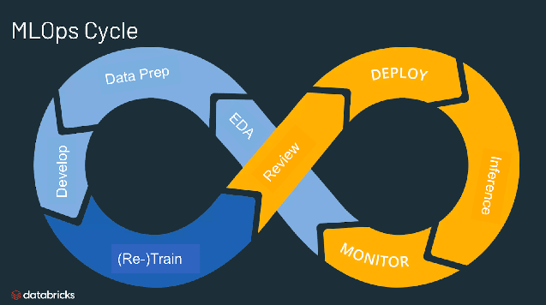
MLOps Lifecycle
https://www.databricks.com/glossary/mlops
Notes:
This slide explains the MLOps Lifecycle, which represents the iterative process of managing machine learning models throughout their lifecycle. The infinity loop emphasizes the continuous and cyclic nature of MLOps workflows.
Phases of the MLOps Cycle:
Data Preparation (Data Prep):
Involves gathering, cleaning, and preparing data for model training.
Ensures data quality and relevance, which are crucial for successful model development.
Exploratory Data Analysis (EDA):
Helps understand the structure, distribution, and patterns in the data.
Involves visualizations and statistical analysis to identify trends and relationships.
Model Development (Develop):
Building and fine-tuning machine learning models using various algorithms.
Includes feature engineering, algorithm selection, and hyperparameter optimization.
Model Training and Retraining (Re-Train):
Train the initial model and continuously retrain it as new data becomes available to maintain performance and relevance.
Automates updates to accommodate changes in data distributions or business requirements.
Model Review:
Evaluating the model’s performance using metrics like accuracy, precision, recall, or RMSE.
Ensures the model meets the expected benchmarks before deployment.
Model Deployment (Deploy):
Implementing the model in a production environment to make real-time or batch predictions.
Focuses on scalability and reliability of serving infrastructure.
Inference:
Using the deployed model to generate predictions or insights from incoming data.
Model Monitoring:
Tracks the performance of the deployed model to identify issues like drift, degradation, or unexpected behaviors.
Triggers retraining or updates when necessary.
Why the Infinity Loop?
The infinity shape illustrates that the MLOps cycle is a continuous process.
Models are constantly retrained, re-evaluated, and updated based on real-world data and feedback, ensuring sustained performance.
Conclusion:
The MLOps lifecycle provides a structured and iterative framework for managing machine learning models from development to deployment and beyond. This process ensures reliability, scalability, and efficiency in production environments.
For more details, the slide refers to Databricks' MLOps glossary.

Slide 30
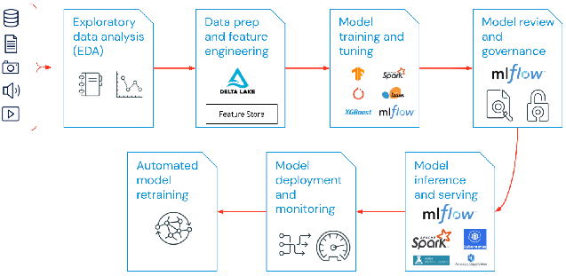
MLOps Components
https://www.databricks.com/glossary/mlops
Notes:
This slide illustrates the key components of the MLOps framework, providing an end-to-end view of the machine learning lifecycle with a focus on automation, scalability, and governance.
Components of MLOps:
Exploratory Data Analysis (EDA):
Objective: Understand data characteristics and distributions.
Activities:
Data visualization and statistical analysis.
Identification of patterns, trends, and anomalies.
Input: Structured and unstructured data from various sources (e.g., databases, images, audio, video).
Data Preparation and Feature Engineering:
Objective: Transform raw data into a usable format for model training.
Tools:
Delta Lake: For managing large datasets with ACID transactions.
Feature Store: Centralized repository for reusable features.
Activities:
Cleaning, normalizing, and encoding data.
Feature extraction and selection.
Model Training and Tuning:
Objective: Build and optimize machine learning models.
Tools:
TensorFlow, PyTorch, Spark MLlib, XGBoost, MLflow.
Activities:
Train models with chosen algorithms.
Tune hyperparameters for better performance.
Model Review and Governance:
Objective: Ensure the model meets compliance and quality standards.
Tools:
MLflow: For tracking experiments, managing model versions, and enforcing governance policies.
Activities:
Model validation and comparison.
Documenting and tracking the development process for auditability.
Model Inference and Serving:
Objective: Deploy the model to production for real-time or batch predictions.
Tools:
MLflow, Apache Spark, Kubernetes.
Activities:
Provide APIs or endpoints for model usage.
Ensure scalability and low latency for predictions.
Model Deployment and Monitoring:
Objective: Track model performance in production.
Activities:
Monitor accuracy, resource utilization, and data drift.
Detect issues like model degradation or bias.
Automated Model Retraining:
Objective: Continuously improve the model using new data.
Activities:
Trigger retraining workflows when data or performance metrics change.
Integrate retraining with feedback loops for adaptive learning.
Key Tools and Technologies:
MLflow: Manages end-to-end MLOps, including tracking, deployment, and governance.
Delta Lake and Feature Store: Enhance data pipeline efficiency and reusability.
TensorFlow, PyTorch, Spark: Widely used libraries for model development.
Conclusion:
This diagram demonstrates how MLOps components work together in a seamless pipeline, ensuring robust, scalable, and reproducible machine learning workflows. The iterative nature ensures continuous model improvement and adaptation to new data.
For more details, refer to Databricks' MLOps Glossary.

Slide 31
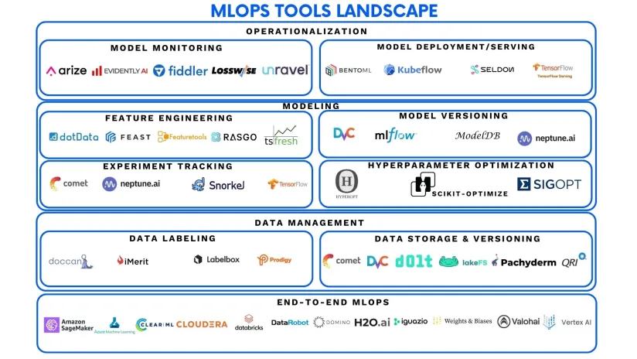
MLOps Tools Landscape
Notes:
This slide illustrates the MLOps Tools Landscape, categorizing tools based on their specific roles within the machine learning lifecycle. These tools collectively streamline the development, deployment, and management of machine learning models.
Key Categories and Tools:
Operationalization:
Model Monitoring: Tools to track the performance and behavior of deployed models.
Examples: Arize AI, Evidently AI, Fiddler, LossWise, Unravel.
Model Deployment/Serving: Tools for deploying models in production and serving predictions.
Examples: Kubeflow, Seldon, TensorFlow Serving, Bentoml.
Modeling:
Feature Engineering: Tools to automate feature extraction, selection, and engineering.
Examples: dotData, FEAST, Featuretools, RASGO, tsfresh.
Model Versioning: Tools to track and manage model iterations and changes.
Examples: DVC, MLflow, ModelDB, Neptune.ai.
Experiment Tracking: Tools to manage and track ML experiments.
Examples: Comet, Snorkel, TensorFlow, Neptune.ai.
Hyperparameter Optimization: Tools to optimize hyperparameters for better model performance.
Examples: SigOpt, Scikit-Optimize, Hyperopt.
Data Management:
Data Labeling: Tools for annotating and labeling datasets for training models.
Examples: Doccano, iMerit, Labelbox, Prodigy.
Data Storage & Versioning: Tools for storing and version-controlling datasets.
Examples: Dolt, LakeFS, Pachyderm, Comet, QRI.
End-to-End MLOps Platforms:
Comprehensive platforms that integrate all stages of the ML lifecycle.
Examples: Amazon SageMaker, Azure ML, Cloudera, Databricks, H2O.ai, Weights & Biases, Vertex AI, DataRobot, Domino.
Purpose:
These tools address specific challenges in MLOps by automating, optimizing, and streamlining various processes.
Using the right combination of tools can lead to more efficient workflows, better collaboration, and faster deployment cycles.
Key Insights:
The ecosystem of MLOps tools is highly diverse and specialized.
Some tools focus on niche tasks (e.g., hyperparameter tuning), while others offer complete end-to-end solutions.
Selecting the appropriate tools depends on the specific needs of the ML project, infrastructure, and team expertise.
Conclusion:
This slide serves as a roadmap for understanding the available MLOps tools and their roles within the lifecycle. By leveraging these tools effectively, organizations can enhance productivity, model performance, and scalability.

Slide 32
MLFlow
MLflow is an open-source platform designed to manage the complete machine learning lifecycle.
Developed by Databricks, MLflow provides a suite of tools to streamline the process of developing, deploying, and monitoring machine learning models.
It is particularly useful for organizations and teams working on multiple machine learning projects that require collaboration, reproducibility, and scalability.
Ref: https://mlflow.org/
Notes:
This slide provides an overview of MLflow, a widely used open-source platform for managing the entire lifecycle of machine learning (ML) projects.
What is MLflow?
Definition: An open-source platform designed to streamline and manage the machine learning lifecycle, from development to deployment.
Developer: Created by Databricks, MLflow simplifies and organizes ML workflows.
Purpose:
Facilitate collaboration among team members.
Enhance reproducibility of experiments.
Scale ML workflows for deployment in production environments.
Features and Benefits:
Lifecycle Management:
Tracks ML experiments, models, and their associated metadata.
Supports various ML lifecycle stages: experimentation, deployment, and monitoring.
Collaboration:
Ideal for teams working on multiple projects, enabling seamless sharing and collaboration.
Tracks experiments across multiple users and environments.
Reproducibility:
Ensures experiments are reproducible by logging inputs, parameters, and results.
Supports version control for models and code.
Scalability:
Designed for scalability to handle enterprise-level ML workflows.
Integrates easily with distributed systems and production-level deployments.
Use Cases:
Teams working on multiple machine learning projects with a need for efficient tracking and collaboration.
Projects that require:
Experiment tracking.
Model versioning and governance.
Deployment into scalable production environments.
Reference:
For more details, visit the official MLflow website: https://mlflow.org.

Slide 33
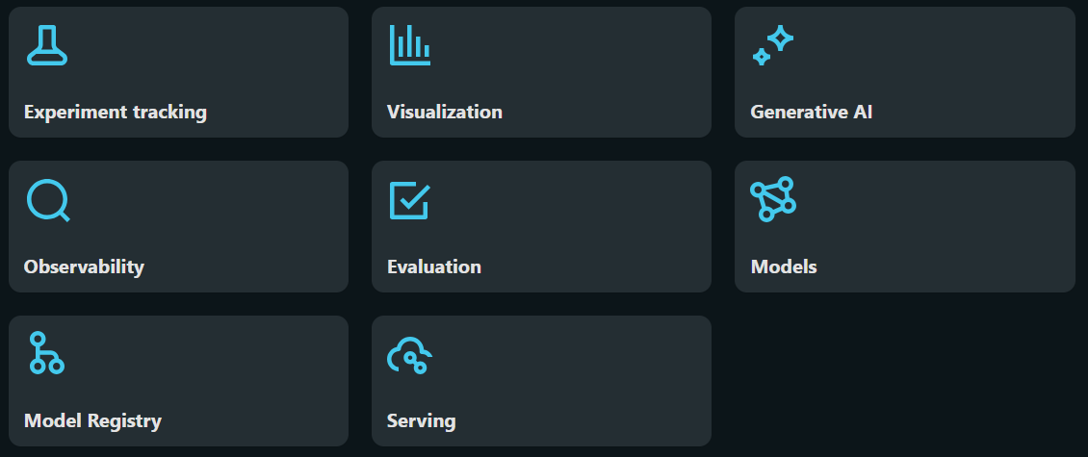
MLFlow Components
Ref: https://mlflow.org/
Notes:
This slide outlines the core MLflow components, essential for managing the complete machine learning lifecycle. Each component serves a specific role to streamline and enhance workflows for machine learning practitioners and teams.
MLflow Components:
Experiment Tracking:
Tracks and organizes ML experiments.
Records parameters, metrics, and artifacts for comparison.
Visualization:
Provides tools to visualize model performance.
Useful for analyzing experiment results graphically.
Generative AI:
Supports workflows for training, fine-tuning, and deploying generative AI models.
Facilitates management of state-of-the-art NLP and image generation tasks.
Observability:
Enables monitoring of model performance and system behavior in production.
Detects anomalies to ensure reliability and scalability.
Evaluation:
Helps in assessing models against various metrics.
Ensures models meet quality standards before deployment.
Models:
Manages trained models and their versions.
Facilitates reusability and reproducibility.
Model Registry:
A central repository for versioning and managing ML models.
Supports transitions from development to production.
Serving:
Offers APIs and pipelines for deploying models in production.
Ensures seamless integration with applications.
Purpose:
These components collectively address the end-to-end requirements of machine learning projects, promoting collaboration, efficiency, and scalability.
Reference:
Detailed documentation can be found at the official MLflow website: https://mlflow.org/.

Slide 34
Experiment Tracking
Purpose: Helps track and log the details of machine learning experiments, such as model parameters, metrics, artifacts, and source code versions.
Features: Provides a user-friendly interface to view and compare multiple experiments, making it easier to reproduce results and manage the progress of different ML models over time.
Notes:
The slide focuses on Experiment Tracking in machine learning, emphasizing its purpose and features within workflows.
Experiment Tracking
Purpose:
Tracks and logs details of ML experiments, such as:
Model parameters.
Metrics.
Artifacts.
Source code versions.
Facilitates organization and management of multiple experiments efficiently.
Features:
User-friendly interface:
Simplifies viewing and comparing multiple experiments.
Enhanced reproducibility:
Eases replication of experiments by maintaining detailed records.
Progress management:
Enables tracking the evolution of machine learning models over time, ensuring continuous improvement.
Significance:
Experiment tracking systems (like MLflow) play a pivotal role in ensuring reproducibility, accountability, and scalability in ML projects, making them indispensable for data scientists and machine learning engineers.

Slide 35
Visualization
Purpose: Offers tools to visualize various metrics and outputs from experiments, such as accuracy, and performance metrics.
Features: Allows users to create interactive plots to analyze and compare results across multiple runs, helping in identifying trends, anomalies, and the best-performing models.
Notes:
Visualization
Purpose:
Provides tools to visualize metrics and outputs from experiments.
Helps in analyzing key metrics like accuracy and other performance indicators.
Features:
Enables creation of interactive plots for:
Comparing results across multiple runs.
Identifying trends and anomalies.
Highlighting the best-performing models.
Significance:
Visualization simplifies complex data, making it easier to interpret experiment results and refine machine learning models. It aids in decision-making and enhances the reproducibility of results.

Slide 36
Generative AI
Purpose: Focuses on functionalities specific to generative AI models, such as managing experiments related to text generation, image synthesis, or other generative tasks.
Features: Could include features for tracking, evaluating, and optimizing generative models, though this specific area may depend on the MLflow version or plugins in use.
Notes:
Generative AI
Purpose:
Focuses on functionalities tailored for generative AI models.
Specifically involves managing experiments for tasks like:
Text generation (e.g., chatbots, language models).
Image synthesis (e.g., GANs, diffusion models).
Other creative and generative tasks.
Features:
Tracking and Logging:
Helps in tracking experiment metadata like model configurations, hyperparameters, and datasets.
Evaluation:
Provides tools for evaluating generated outputs (e.g., BLEU scores for text, FID for images).
Optimization:
Aims at optimizing generative models by automating processes like hyperparameter tuning.
Plugin Support:
May depend on the MLflow version or specific plugins for advanced generative AI capabilities.
Significance:
Generative AI has wide applications, from creative content generation to realistic simulations in fields like NLP, computer vision, and reinforcement learning.
This component ensures proper tracking, evaluation, and deployment of generative models for efficient experimentation and reproducibility.

Slide 37
Observability
Purpose: Provides insights into the operational aspects of ML models, such as monitoring model performance, drift, and data changes over time.
Features: Helps track models in production, ensuring they continue to perform as expected. It might include alerts for model degradation or unexpected behavior.
Notes:
Observability
Purpose:
Provides insights into the operational aspects of machine learning (ML) models.
Focuses on monitoring key aspects such as:
Model performance (e.g., accuracy, precision, recall).
Model drift (e.g., changes in input data or predictions over time).
Data changes that may affect the model's outcomes.
Features:
Tracking Model Performance:
Continuously monitors how well the model is performing in a production environment.
Alerting:
Sends alerts for anomalies like:
Model degradation (e.g., declining accuracy).
Unexpected behaviors in predictions or outputs.
Ensures Reliability:
Tracks the health of deployed models to ensure they perform as expected in real-world scenarios.
Significance:
Operational Monitoring: Essential for maintaining model reliability and ensuring performance aligns with business goals.
Proactive Issue Detection: Enables teams to identify and resolve issues (e.g., data drift) before they impact end-users or applications.
Continuous Improvement: Helps adapt models to changing environments by identifying when retraining or updates are necessary.

Slide 38
Evaluation
Purpose: Offers tools to evaluate model performance based on different metrics.
Features: Can automate the process of evaluating models against specific criteria or datasets, providing a consistent method to assess model quality and suitability for deployment.
Notes:
Evaluation
Purpose:
Provides tools to assess model performance by comparing outputs with specific evaluation metrics.
Helps determine whether a model is suitable for deployment by testing its quality and accuracy.
Features:
Automated Evaluation:
Automates the process of comparing models against predefined datasets or evaluation criteria.
Consistency:
Ensures a standardized method for assessing the performance of different models, facilitating objective comparisons.
Deployment Readiness:
Evaluates models on factors such as accuracy, precision, recall, and other relevant metrics to verify their suitability for real-world deployment.
Significance:
Quality Assurance: Ensures only high-performing models are selected for production.
Improves Workflow: Streamlines the process of testing and validating models.
Informed Decision-Making: Provides insights into areas of improvement and helps choose the best-performing model.

Slide 39
Models
Purpose: Central place to manage different versions of models.
Features: Includes a model repository where users can register and store trained models, manage model versions, and track their deployment status. It enables collaboration among teams by sharing model artifacts and versions.
Notes:
This slide on Models highlights the purpose and features of a centralized repository for managing machine learning models:
Purpose:
To serve as a central hub for managing various versions of trained models.
Features:
Model Repository: A dedicated space for registering and storing trained models.
Version Management: Enables users to track different versions of models for easy retrieval and deployment.
Collaboration: Facilitates sharing of model artifacts and versions across teams, promoting collaborative development.
Deployment Tracking: Monitors the deployment status of models, ensuring streamlined workflow in production.
This system is crucial in environments where multiple teams are involved in the lifecycle of machine learning models, ensuring consistency and efficiency.

Slide 40
Model Registry
Purpose: Provides a collaborative platform to manage the full lifecycle of machine learning models, from development to deployment.
Features: Supports model versioning, stage transitions (such as staging to production), annotations, and approval processes. Ensures a controlled and organized way to handle model versions and their lifecycle management.
Notes:
The slide on Model Registry highlights its purpose and features, focusing on the efficient lifecycle management of machine learning models:
Purpose:
Collaborative Platform: Acts as a centralized system to manage the entire lifecycle of machine learning models, from development through deployment.
Ensures streamlined collaboration across teams working on model development and deployment.
Features:
Model Versioning: Maintains a record of all versions of a model for easy comparison and retrieval.
Stage Transitions: Supports the transition of models through various stages, such as "staging" to "production," ensuring controlled rollouts.
Annotations: Allows adding notes and metadata to models for better understanding and tracking.
Approval Processes: Facilitates review and approval workflows, ensuring only validated models move to production.
Organized Management: Provides a structured framework for handling the lifecycle of model versions, reducing errors and increasing productivity.
This is a critical tool in machine learning pipelines to ensure traceability, consistency, and collaboration in model management.

Slide 41
Serving
Purpose: Facilitates the deployment of ML models to production environments.
Features: Provides tools to deploy models as REST APIs or integrate them into existing applications or microservices, supporting real-time predictions and scalability. It helps automate the deployment process and ensures models are easily accessible for use.
Notes:
The slide on Serving explains how machine learning models are deployed and integrated into production environments for real-time use.
Purpose:
Deployment: Ensures that machine learning models can be deployed into production environments effectively and made accessible for real-world applications.
Features:
REST APIs and Microservices: Provides tools to expose models as REST APIs or integrate them into existing applications or microservices.
Real-Time Predictions: Supports live, on-demand predictions for dynamic use cases.
Automation: Helps automate the deployment process, reducing manual effort and increasing efficiency.
Scalability: Ensures that models can handle growing user demands by scaling effectively.
Ease of Access: Makes deployed models readily available for end-users or systems to interact with.
This component is essential in bridging the gap between model development and practical application, ensuring models deliver actionable insights or services in real-time environments.

Slide 42
MLFlow Demo for Covid Dataset
Objective
To demonstrate a simple MLOps experiment using the “MLFlow” tool
Main (function)
-> preprocess_data
-> train_model
-> evaluate_model
-> log_to_mlflow
Notes:
This slide outlines a demonstration using MLFlow to manage a machine learning experiment on a COVID dataset.
Objective:
The goal is to showcase how MLFlow can be used as part of an MLOps pipeline to streamline experiment tracking and lifecycle management.
Main Components in the Workflow:
preprocess_data:
Handles data cleaning, transformation, and preparation.
Ensures the dataset is ready for model training by addressing missing values, scaling, or encoding features.
train_model:
Implements the training of a machine learning model on the prepared data.
Likely includes model selection and hyperparameter tuning.
evaluate_model:
Assesses the model's performance using appropriate metrics (e.g., accuracy, precision, recall for classification tasks).
May include validation on a test dataset.
log_to_mlflow:
Logs key artifacts such as:
Metrics
Model parameters
Trained models
Source code
Utilizes MLFlow for tracking and reproducibility.
This structured approach integrates MLOps best practices and highlights MLFlow's capability in managing and scaling experiments effectively.

Slide 43
Metrics Summary
Accuracy (0.785): The model correctly predicted about 78.5% of the instances.
CPU Usage (22.4%): The model used 22.4% of the CPU's processing capacity during execution.
F1-Score (0.785): The model's balance between precision and recall is approximately 78.5%.
False Negative (48): The model incorrectly classified 48 positive instances as negative.
False Positive (1): The model incorrectly classified 1 negative instance as positive.
Memory Usage (94.3%): The model used 94.3% of the system's memory during execution.
Model Training Time (0.3128 seconds): The model took about 0.31 seconds to train.
Precision (0.785): Around 78.5% of the model's positive predictions were correct.
Recall (0.785): The model correctly identified 78.5% of all actual positive instances.
True Negative (192): The model correctly identified 192 negative instances.
True Positive (2): The model correctly identified 2 positive instances.
Notes:
The Metrics Summary slide provides a detailed performance evaluation of a machine learning model, with metrics covering accuracy, resource utilization, and classification results.
Key Insights:
Model Performance Metrics:
Accuracy (0.785): The model correctly predicted 78.5% of the instances.
F1-Score (0.785): Indicates the harmonic mean of precision and recall, suggesting balanced performance.
Precision (0.785): Out of all positive predictions, 78.5% were accurate.
Recall (0.785): Out of all actual positive instances, 78.5% were correctly identified.
Error Analysis:
False Negatives (48): Instances wrongly classified as negatives.
False Positives (1): Instances wrongly classified as positives.
True Negatives (192): Correctly identified negative instances.
True Positives (2): Correctly identified positive instances.
Resource Utilization:
CPU Usage (22.4%): Shows efficient utilization of processing capacity.
Memory Usage (94.3%): Indicates a high memory demand during execution.
Training Time:
Model Training Time (0.3128 seconds): Highlights a very fast training phase, suitable for quick iterations.
Implications:
While the accuracy and F1-score are consistent, the low True Positives (2) compared to False Negatives (48) suggests room for improvement in identifying positive cases.
Resource consumption metrics (CPU and Memory) indicate the model is demanding, which may need optimization for large-scale deployment.
The fast training time reflects computational efficiency, ideal for iterative processes.
This analysis supports targeted improvements to enhance the model's capability, especially in identifying positive instances.

Slide 44
MLFlow - Artifacts
MLmodel: Defines the model's metadata and structure, specifying the model type, dependencies, and entry points for loading and running the model.
conda.yaml: Captures the Conda environment configuration, listing all dependencies and their versions to recreate the environment for running the model.
model.pkl: Stores the serialized (pickled) version of the trained model, allowing it to be loaded and used for predictions without retraining.
python_env.yaml: Specifies the Python environment, including the Python version and pip dependencies, ensuring the model runs consistently across different setups.
requirements.txt: Lists all Python dependencies required to run the model, serving as an alternative to conda.yaml for environments that use pip instead of Conda.
Notes:
The MLFlow - Artifacts slide outlines the key components generated and stored during a machine learning experiment using MLFlow. These artifacts ensure model reproducibility, ease of deployment, and environment consistency.
Key Artifacts and Their Purposes:
MLmodel:
Purpose: Acts as the metadata file for the model.
Details: Specifies the model type, dependencies, and entry points for loading and running the model. This file is critical for interpreting the structure of the model.
conda.yaml:
Purpose: Captures the Conda environment configuration.
Details: Lists all dependencies (libraries and their versions) to recreate the exact environment needed for the model. Essential for ensuring compatibility during model reuse.
model.pkl:
Purpose: Stores the serialized version of the trained model.
Details: The pickled model file allows predictions to be made without retraining. It’s lightweight and commonly used for deployment.
python_env.yaml:
Purpose: Describes the Python environment.
Details: Specifies the Python version and pip dependencies. It ensures consistency in the execution of the model across different platforms or setups.
requirements.txt:
Purpose: Lists all Python dependencies required to run the model.
Details: An alternative to conda.yaml, this file is particularly useful for environments that use pip rather than Conda for package management.
Importance:
These artifacts collectively enable reproducibility, portability, and scalability of ML models.
They simplify the process of moving a model from development to production by ensuring that all required dependencies and configurations are clearly documented and available.
These artifacts serve as a robust framework for managing and deploying machine learning models in an organized and systematic manner.

Slide 45
Types of System Metrics in MLFlow
cpu_utilization_percentage
system_memory_usage_megabytes
system_memory_usage_percentage
gpu_utilization_percentage
gpu_memory_usage_megabytes
gpu_memory_usage_percentage
gpu_power_usage_watts
gpu_power_usage_percentage
network_receive_megabytes
network_transmit_megabytes
disk_usage_megabytes
disk_available_megabytes
Ref - https://mlflow.org/docs/latest/system-metrics/index.html
Notes:
This slide highlights System Metrics in MLFlow, which monitor and log resource utilization during machine learning experiments. These metrics ensure efficient usage of computational resources and help in diagnosing performance issues.
Key Metrics and Their Descriptions:
CPU Metrics:
cpu_utilization_percentage: Tracks the percentage of CPU usage, useful for understanding computational load during model training and evaluation.
Memory Metrics:
system_memory_usage_megabytes: Logs the memory (RAM) consumed in megabytes.
system_memory_usage_percentage: Records memory usage as a percentage of the total system memory.
GPU Metrics:
gpu_utilization_percentage: Measures GPU usage in percentage, indicating the intensity of GPU processing.
gpu_memory_usage_megabytes: Tracks the amount of GPU memory consumed in megabytes.
gpu_memory_usage_percentage: Represents GPU memory usage as a percentage of total available GPU memory.
gpu_power_usage_watts: Logs the GPU power consumption in watts, helping evaluate energy efficiency.
gpu_power_usage_percentage: Measures GPU power usage relative to the maximum capacity.
Network Metrics:
network_receive_megabytes: Records data received over the network in megabytes, useful for tracking data-intensive operations like streaming datasets.
network_transmit_megabytes: Tracks the amount of data transmitted, aiding in monitoring communication overhead.
Disk Metrics:
disk_usage_megabytes: Logs the amount of disk space consumed during experiments, useful for monitoring large datasets or model storage.
disk_available_megabytes: Tracks the remaining available disk space, ensuring experiments do not run out of storage.
Importance:
These metrics provide insights into resource utilization, enabling optimization of hardware usage.
They help in identifying potential bottlenecks during training or inference, such as high memory or disk usage.
Monitoring GPU and CPU metrics ensures that experiments are running efficiently on the allocated hardware.
Use Cases:
Performance Benchmarking: Compare system performance across different runs or environments.
Cost Efficiency: Optimize computational resources to reduce costs in cloud-based setups.
Debugging: Identify resource contention issues or hardware inefficiencies.
These metrics are essential for robust MLOps practices and ensure the scalability and reliability of machine learning workflows.

Slide 46

MLOps Demo using SageMaker
Amazon SageMaker is a MLOps platform
Build, train, and deploy machine learning (ML) models for any use case with fully managed infrastructure, tools, and workflows
Notes:
This slide introduces Amazon SageMaker, a comprehensive MLOps platform designed to manage the end-to-end lifecycle of machine learning models. Here's a detailed explanation:
Key Features of Amazon SageMaker:
Fully Managed Platform:
Provides infrastructure, tools, and workflows for building, training, and deploying machine learning models without worrying about underlying hardware and scalability.
End-to-End ML Lifecycle Support:
From data preprocessing to model deployment and monitoring, SageMaker streamlines the entire ML pipeline.
Supports Multiple Frameworks and Languages:
Compatible with popular machine learning libraries and frameworks such as:
TensorFlow
PyTorch
MXNet
Hugging Face
Scikit-learn
Allows development in programming languages like Python and R, making it versatile for various data science workflows.
Integration with Jupyter Notebooks:
Offers managed Jupyter Notebooks for seamless development and experimentation, improving accessibility and productivity.
Why Use SageMaker for MLOps?
Scalability: Automatically provisions resources based on model training and inference requirements.
Automation: Features like automatic model tuning, deployment, and monitoring simplify repetitive tasks.
Cost Efficiency: Pay-as-you-go pricing ensures optimized costs for resource utilization.
Deployment: Models can be deployed as real-time endpoints or batch jobs with minimal effort.
Collaboration: Enables teams to share experiments, datasets, and results efficiently.
Use Cases:
Ideal for projects requiring quick prototyping, large-scale training, or real-time deployment, such as:
Predictive analytics
Image classification
Natural language processing (NLP)
Recommender systems
Amazon SageMaker is a powerful tool for organizations aiming to scale their machine learning operations while maintaining efficiency and reliability.

Slide 47
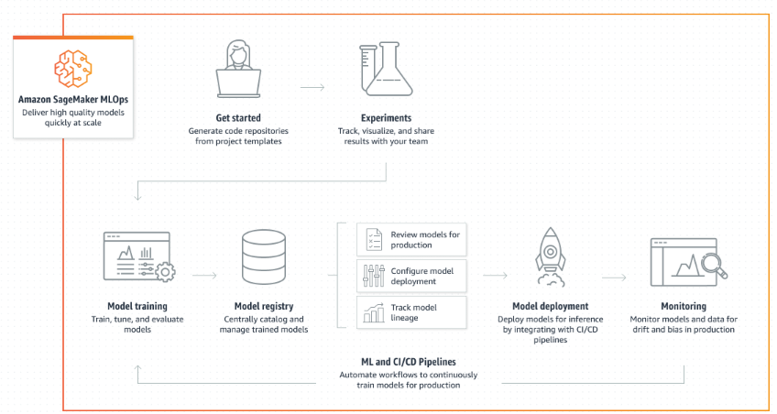
SageMaker
https://aws.amazon.com/sagemaker/mlops/?sagemaker-data-wrangler-whats-new.sort-by=item.additionalFields.postDateTime&sagemaker-data-wrangler-whats-new.sort-order=desc
Notes:
This slide introduces Amazon SageMaker, a comprehensive MLOps platform designed to manage the end-to-end lifecycle of machine learning models. Here's a detailed explanation:
Key Features of Amazon SageMaker:
Fully Managed Platform:
Provides infrastructure, tools, and workflows for building, training, and deploying machine learning models without worrying about underlying hardware and scalability.
End-to-End ML Lifecycle Support:
From data preprocessing to model deployment and monitoring, SageMaker streamlines the entire ML pipeline.
Supports Multiple Frameworks and Languages:
Compatible with popular machine learning libraries and frameworks such as:
TensorFlow
PyTorch
MXNet
Hugging Face
Scikit-learn
Allows development in programming languages like Python and R, making it versatile for various data science workflows.
Integration with Jupyter Notebooks:
Offers managed Jupyter Notebooks for seamless development and experimentation, improving accessibility and productivity.
Why Use SageMaker for MLOps?
Scalability: Automatically provisions resources based on model training and inference requirements.
Automation: Features like automatic model tuning, deployment, and monitoring simplify repetitive tasks.
Cost Efficiency: Pay-as-you-go pricing ensures optimized costs for resource utilization.
Deployment: Models can be deployed as real-time endpoints or batch jobs with minimal effort.
Collaboration: Enables teams to share experiments, datasets, and results efficiently.
Use Cases:
Ideal for projects requiring quick prototyping, large-scale training, or real-time deployment, such as:
Predictive analytics
Image classification
Natural language processing (NLP)
Recommender systems
Amazon SageMaker is a powerful tool for organizations aiming to scale their machine learning operations while maintaining efficiency and reliability.

Slide 48
Sagemaker Canvas vs Studio
SageMaker Canvas: Low-code/no-code interface designed to make it easier for users without extensive machine learning expertise to build, train, and deploy machine learning models. It offers a visual interface where users can drag and drop components to define the data flow and model training process.
SageMaker Studio: Is an integrated development environment (IDE) for machine learning. It provides a full-featured environment for data scientists and machine learning engineers to build, train, tune, deploy, and monitor machine learning models at scale. SageMaker Studio offers a range of tools and features, including Jupyter notebooks, experiment management, model debugging, and automated model tuning.
Notes:
This slide provides a high-level overview of Amazon SageMaker MLOps and its workflow. Here's a detailed breakdown:
Workflow Components in SageMaker MLOps
Get Started:
Generates code repositories from project templates to help users quickly set up ML projects.
Provides a streamlined beginning for developing machine learning workflows.
Experiments:
Enables tracking, visualization, and sharing of experiment results within teams.
Facilitates collaborative experimentation and analysis to refine models.
Model Training:
Offers tools to train, tune, and evaluate models efficiently.
Ensures optimal performance by supporting various frameworks and hyperparameter tuning.
Model Registry:
A centralized catalog to manage trained models.
Tracks model versions and manages model lineage for better reproducibility and organization.
Review and Configure:
Helps in reviewing models for production readiness.
Configures model deployments seamlessly, ensuring integration into production environments.
Model Deployment:
Deploys models for inference by integrating with CI/CD pipelines.
Supports real-time, batch inference, and custom deployments as required.
Monitoring:
Monitors models and datasets for issues like drift, bias, or performance degradation in production.
Ensures continuous evaluation to maintain model reliability.
ML and CI/CD Pipelines:
Automates workflows to train, test, and deploy models for production.
Integrates with modern DevOps tools for seamless collaboration and deployment.
Why Use Amazon SageMaker MLOps?
Scalability: Manages large-scale ML operations efficiently.
Collaboration: Enhances teamwork through shared experiments and a centralized registry.
Automation: Simplifies repetitive tasks like retraining and deployment.
Monitoring: Maintains model quality in production with continuous oversight.
This workflow illustrates the comprehensive capabilities of SageMaker MLOps for managing the entire lifecycle of machine learning models, from initial setup to deployment and monitoring.

Slide 49
Sagemaker
Data Wrangler
Dataset: “Pima Indian Diabetes” Dataset
Model: AutoML model created by SageMaker [Auto ml systems automatically find, select, and optimize the best machine-learning model for a given dataset using sophisticated methods and techniques. ]
Model Building: Select dataset -> Build -> Analyze -> Predict -> Deploy
[It will deploy to an endpoint, from where predictions can be made]
5. SageMaker Model Registry - SageMaker Model Registry can be used to catalog and manage different model versions.
Notes:
This slide outlines the features and workflow of Amazon SageMaker for building and deploying machine learning models:
Key Points
Data Wrangler:
A tool within SageMaker used for preparing and visualizing data.
Helps clean, transform, and analyze datasets for machine learning.
Dataset:
Example used: Pima Indian Diabetes Dataset.
This is a well-known dataset used for predicting diabetes based on specific patient features.
Model:
AutoML Model:
SageMaker automates the process of model selection and optimization.
Leverages AutoML to identify the best machine learning model for the dataset.
Uses advanced methods to tune hyperparameters and improve performance.
Model Building Workflow:
Step-by-step process:
Select Dataset: Choose the dataset for analysis.
Build: Use SageMaker tools to preprocess and structure the data.
Analyze: Generate insights and exploratory analysis.
Predict: Train the model and make predictions.
Deploy: Deploy the model to an endpoint for real-time or batch inference.
SageMaker Model Registry:
A feature that allows cataloging and managing model versions.
Ensures smooth lifecycle management by keeping track of:
Model iterations.
Staging, approval, and production deployment processes.
How It Works in Practice
SageMaker simplifies the end-to-end machine learning pipeline, starting from data preparation to model deployment.
Models are deployed to endpoints for predictions, making it easy to integrate into applications.

Slide 50
Sagemaker
DEMO

Slide 51
Git Repositories
Data Science Project for Covid Dataset
Repo - https://github.com/shreyassureshrao/covid-datascienceproject.git
2. Prefect – Data Science Project
Repo – https://github.com/shreyassureshrao/dsp.git
3. MLFlow code
Repo – https://github.com/shreyassureshrao/MLFlow-code.git
4. SageMaker code
Repo - https://github.com/shreyassureshrao/sagemaker-endpoint-code.git

Slide 52
Revision for Mid-Sem Exam
(Self Study)
[Course Material uploaded to MS Teams]

Slide 53
Thank You!

